Slide 1
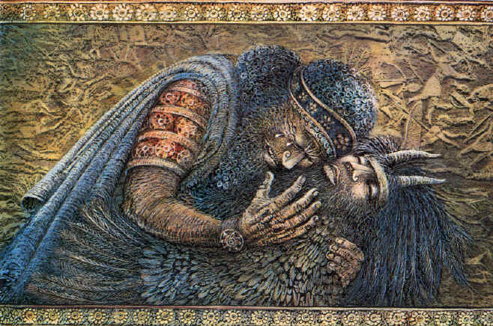
After Enkidu’s Dream…
The Death of Enkidu.

Slide 2
Anu decides that either Gilgamesh or Enkidu must be punished for killing Humbaba.
Enlil is the one who pushes for Enkidu’s death as he tells the rest of the gods that it was he who had slain Humbaba. Shamash does try to defend them but proves unsuccessful.
Enkidu becomes ill and is over-come with self-pity. Gilgamesh, meanwhile, is distraught with the news and vows to plead his case to the gods. Ultimately unsuccessful, Gilgamesh vows to build and even greater monument than the cedar gate (made entirely of gold) in Enkidu’s honor.

Slide 3
Enkidu, bitter about his fate, curses Shamash, the trapper, and the temple harlot. Shamash hears this and tells him that Gilgamesh will end up wandering the Earth undone by grief. This makes Enkidu feel better.
Enkidu suffers for twelve more days and then dies. :’(
This sends Gilgamesh into a rage; he circles Enkidu’s body like an eagle. He commands the monument be built and stays by his friends body while this is being completed.
Gilgamesh tears off his kingly garb and replaces it with ragged animal skins. He sets out into the wilderness just as Shamash had foretold to Enkidu.

Slide 4
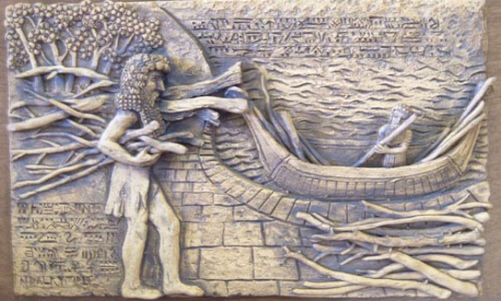
While wandering aimlessly and contemplating his own death, he decides to seek out Utnapishtim; the guy who survived the great flood and only mortal to have ever been granted eternal life.
Gilgamesh slays a bunch of lions along the way (no big deal) and revels in the slaughter.
He meets two monsters that guard the tunnel in which he must pass through to find Utnapishtim. Once though the tunnel he finds a beautiful garden filled with fruit, jewels, and the sea just ahead.

