Slide 1
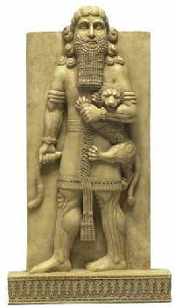
The Story of Enkidu Tablet 1
Gilgamesh is young and brash, and perhaps unthinkingly oppresses the people of Uruk with his superhuman strength.
He challenges all the young men to fight in contests of strength – they don’t get to rest because Gilgamesh is 2/3 god and doesn’t tire as easily as they do.
He exercises his kingly “rights” over brides on their wedding nights.
The people complain to the gods about Gilgamesh.

Slide 2
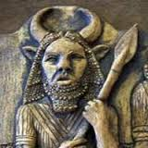
The Story of Enkidu Tablet 1, continued
Anu, the sky god and father of the gods, asks the goddess Aruru, the creator of mankind, to make a man who could be an equal for Gilgamesh
Aruru forms Enkidu from clay. He is a wild man who lives among the animals and grazes with the gazelles. “His whole body was covered thickly with hair, his head covered with hair like a woman's/the locks of his hair grew abundantly, like those of the grain god Nisaba.”
A trapper sees Enkidu and is disturbed that a man should be living among the animals. His father tells him to bring the temple priestess/harlot, Shamhat, to Enkidu so that she can civilize him.

Slide 3
The Story of Enkidu Tablet 2
Enkidu and Shamhat are intimate for 7 days. Shamhat represents the mysterious, transformative power of physical love as the embodiment of the love goddess Ishtar.
This experience changes Enkidu. He can no longer physically keep up with the animals, and they run away from him.
Shamhat takes Enkidu to live with some shepherds; he protects their flocks from the wild beasts.
Shamhat continues to teach Enkidu. She gives him clothing, educates him in the ways of men, and shows him how to drink from a cup.
Enkidu is now prepared to enter the city and assume his role as a balancing force in Gilgamesh’s life.

Slide 4
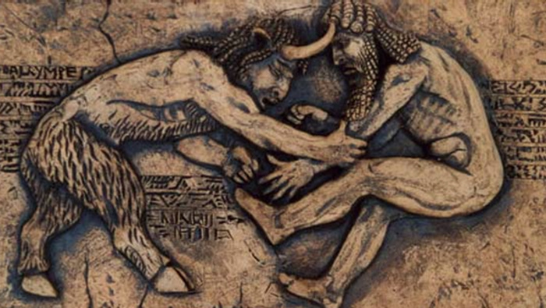
The Story of Enkidu
In the meantime, Gilgamesh dreams about the coming of a man who will be his friend and equal. Gilgamesh longs for a friend. In fact, Gilgamesh has already had two dreams about Enkidu. In the first dream, a meteor lands in a field outside Uruk. Gilgamesh is drawn to the rock as if it were a woman. After lifting it with great effort, he carries it to his mother, Ninsun. In the second dream, Gilgamesh finds an axe lying in the street. Throngs of people surround it, overcome with admiration. Gilgamesh too loves the axe, as much as if it were his wife. He carries it to his mother and lays it at her feet. Ninsun tells him that both the rock and the axe represent the man he will soon contend with.

Slide 5
The Story of Enkidu
When Enkidu hears about Gilgamesh and his bad behavior with the brides, he goes to Uruk to challenge him.
As Enkidu enters the city, Gilgamesh is about to claim first right to a new bride. Infuriated at this abuse, Enkidu stands in front of the door of the marital chamber and blocks Gilgamesh's way.
Noble savage challenges the civilized brute.
They fight and Gilgamesh wins.
The two become devoted friends.

Slide 6
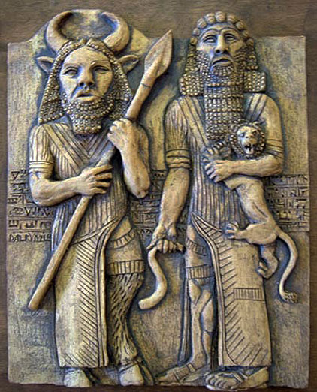
“Bros for Life”

