Slide 1
Persuasion Is All Around You!
“Can You Hear Me Now?”

Slide 2
What is persuasion?
A means of convincing people:
to buy a certain product
to believe something or act in a certain way
to agree with a point of view

Slide 3
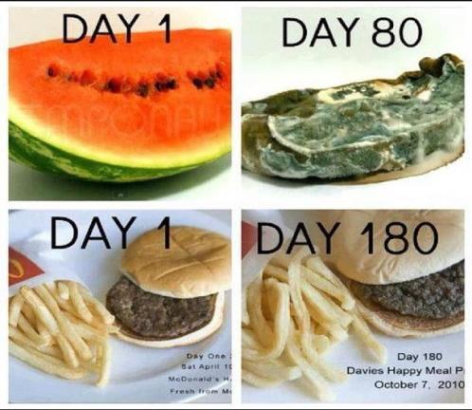
Logos
The impact of logos refers to an argument’s logical appeal.
Yummy!

Slide 4
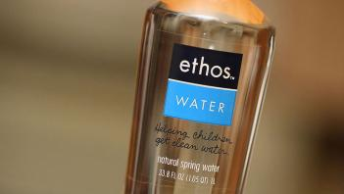

Ethos
The impact of ethos on an audience is often referred to as an argument's ethical appeal.
Buy these products because it is for a good cause.

Slide 5


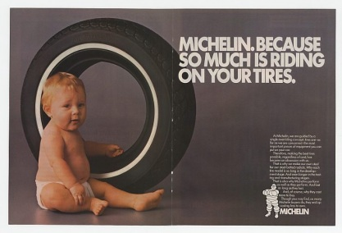
Pathos
Pathos thus refers to the emotional impact of the message on an audience, the power with which the writer's message moves the audience to decision or action.

Slide 6

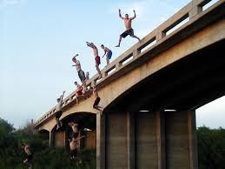
Bandwagon
A statement suggesting that everyone is using a specific product or buying into an idea, so you should too.

Slide 7
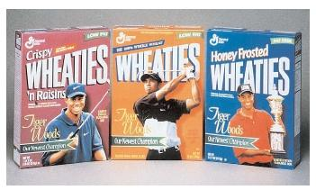
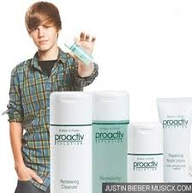
Testimonial
A well-known person supports a product or service, or idea

Slide 8
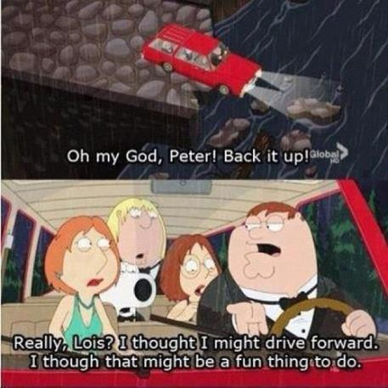
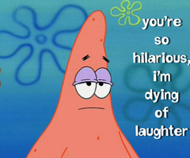
Verbal Irony
When a speaker says one thing but intends the opposite.

Slide 9

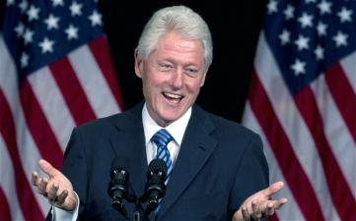
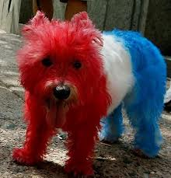
Patriotism
Appealing to the audience’s love for their country.
Hey! Vote for me because there is a flag behind me.
USA! USA! USA!

Slide 10
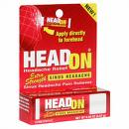
Repetition:
The name of a product is repeated many times
HEAD ON Apply directly to the forehead
HEAD ON Apply directly to the forehead
HEAD ON Apply directly to the forehead

Slide 11
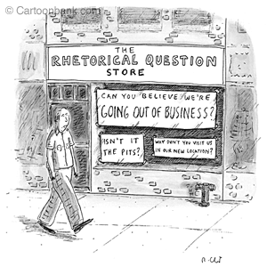
Rhetorical Question
A question asked merely for effect with no answer expected.

Slide 12
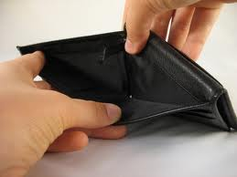
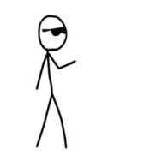
Visual Effect
An image to promote buy in from your audience.
Ummm, Mom, I need some money, please.

Slide 13
Audience Awareness
Advertisers know how to
target their audiences
use appropriate persuasive technique

Slide 14

Who’s the audience?

Slide 15

Audience?

Slide 16

Audience?
Purpose?
Persuasive technique?

Slide 17
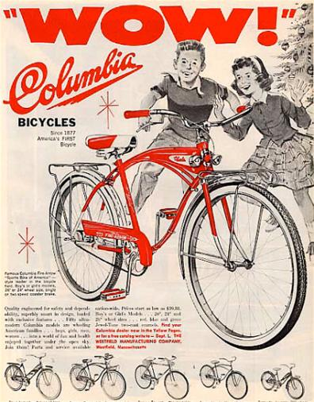
Audience?
Purpose?
Persuasive technique?

Slide 18
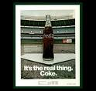
Audience?

Slide 19
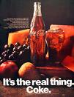
Audience?
Purpose?

Slide 20
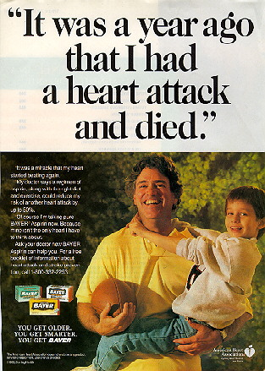
Audience?
Purpose?

Slide 21

Audience?
Purpose?
Persuasive technique?

Slide 22

Audience?
Persuasive technique?

Slide 23
Relevant facts
Advertisers spend about $200 billion a year on TV advertising
The average cost for Super Bowl ads is $2.6 million per 30 second spot
The average American watches about 24,000 TV commercials a year
http://television-commercial.net/

Slide 24
Making Connections
What is your favorite jingle?
What slogan for a product do you find yourself saying?
What TV commercial has influenced you to make a purchase?
Since Tubby Smith and Billy Gillispie shop at Kroger, does that mean we should too?

Slide 25
Reflection
“Persuasion is all around you”
In addition to TV commercials, where else do you see persuasion all around you? Is that persuasion influencing you or your family in any way? Explain.

Slide 26
Jennifer Bernhard
Literacy Specialist
Clark County Schools
Jennifer.bernhard@clark.kyschools.us

Slide 27
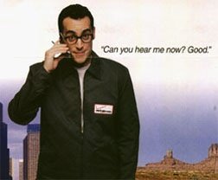

Slogan: “Can you hear me now?”
A catchy phrase or statement often used to sell a service or a product

Slide 28

Expert opinion
Experts approve this product, so you should use it
“Four out of five dentists recommend sugarless gum for their patients who chew gum”

