Slide 1
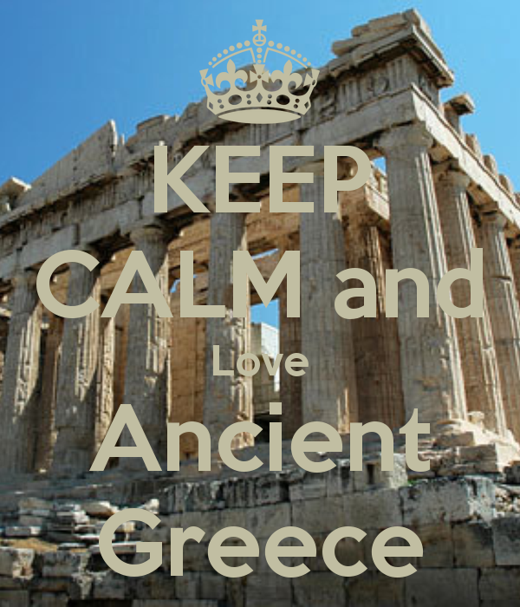
Antigone
2016

Slide 2
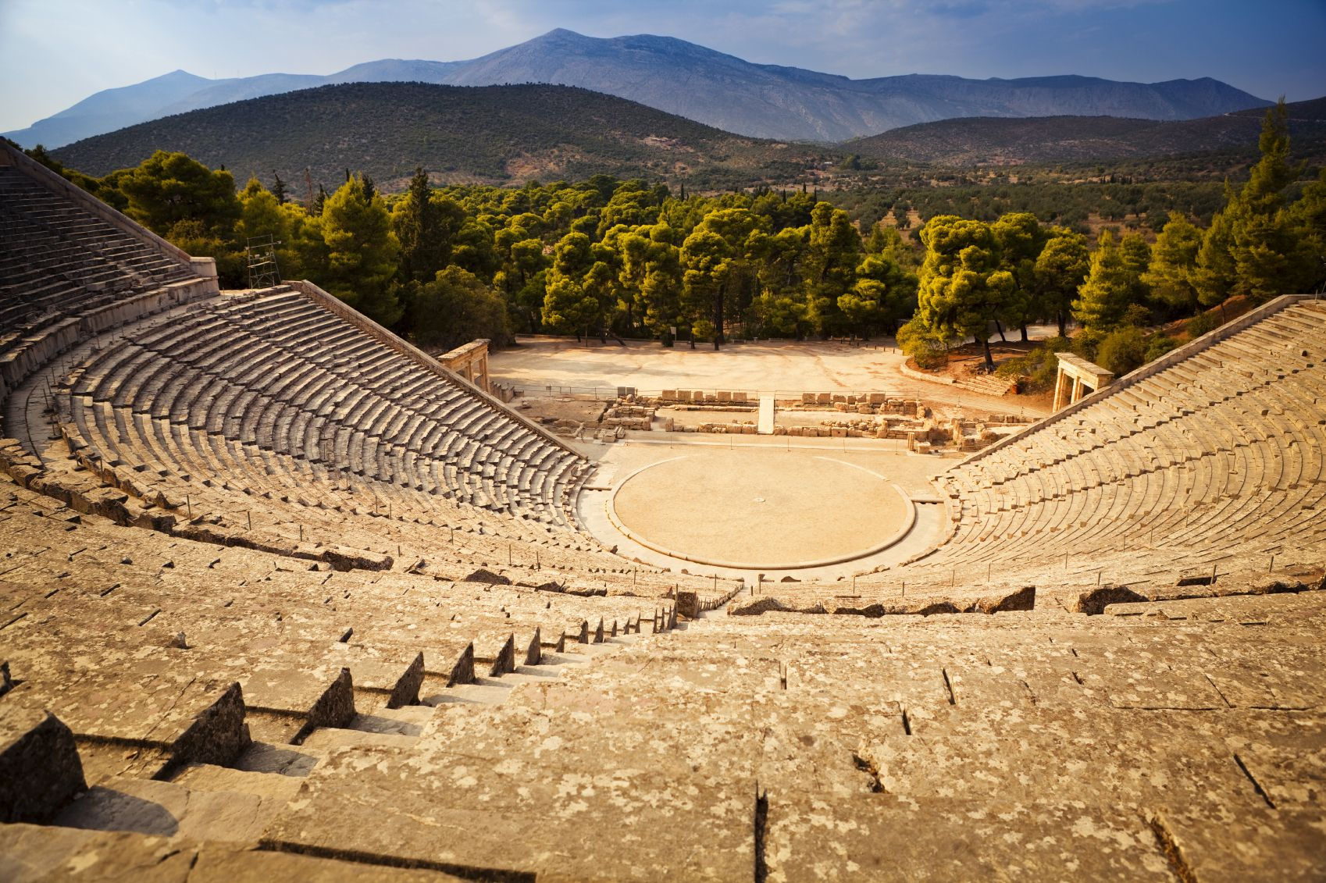
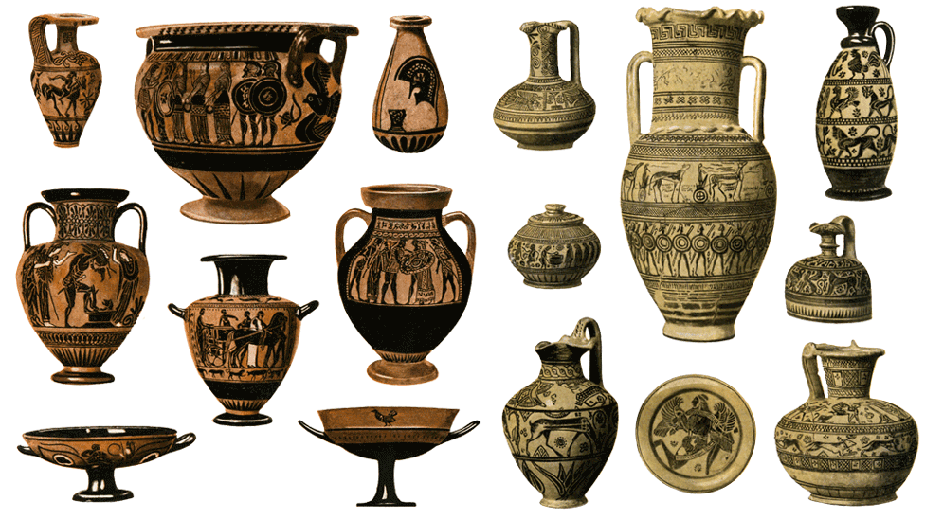

Slide 3
Sophocles
496 – 406 B. C.
Worked as a public official
Wrote 123 plays, all about misery and tragedy
Only 7 of his plays are still around today
His plays depict characters caught up in unsolvable dilemmas that test their faith in divine and human justice

Slide 4
Tragedy:
the word "tragedy" refers primarily to tragic drama: a literary composition written to be performed by actors in which a central character called a tragic protagonist or hero suffers some serious misfortune which is not accidental or meaningless, and is significant in that the misfortune is logically connected with the hero's actions.

Slide 5
Tragedy:
Tragedy stresses the vulnerability of human beings whose suffering is brought on by a combination of human and divine actions, but is generally undeserved with regard to its harshness.
Tragedy is the imitation of action
Tragedy shows rather than tells
Tragedy is higher and more philosophical than history because history states what has happened while tragedy shows what MAY happen.

Slide 6
Tragedy:
Tragedy is rooted in the order of the universe; it creates a cause and effect chain that clearly reveals what may happen at any time or place because that is the way the world operates. Think – Butterfly effect.
Tragedy evokes feeling of pity for the protagonist, but also fear in the audience because the audience can envision themselves within the characters and events.

Slide 7
Catharsis is the purging or cleansing of the tragic emotions of pity and fear.
This occurs at the end of the tragedy.
Aristotle believed that there is a pleasure to tragedy—he thought that the pleasure people get from contemplating the pity and fear also allowed them to purge away their own feelings of pity and fear.

Slide 8
Tragic protagonist
strong extraordinary character
of noble birth (aristocrat or royalty)
Great Weakness (tragic flaw) leads to ultimate downfall
Typically “hubris”- more commonly referred to as pride.
has a moment of Tragic Choice which spirals into the downfall of hero
Downfall always includes death in a traditional tragedy
Downfall also brings about far-reaching catastrophe: many deaths, downfall of family, kingdom or society

Slide 9
Antigone Themes
Includes themes of
To what lengths would/should you go to maintain your identity?
Should your loyalty be stronger to your family or your state?
Are the laws of God greater than the laws of man?

Slide 10
Ethos Pathos Logos
Ways we persuade people
Logos- appeals to logic
Ethos- an appeal to ethics
Pathos-emotions (Greek root “path” means feeling)

Slide 11
Second Part of the Oedipus trilogy
Oedipus-killed father married mother
Had 4 children with Jocasta (mom)
Jocasta hangs self when she realizes
Oedipus blinds self and is banished
Creon (brother in law of Oedipus) becomes king of Thebes
Antigone is the story of Oedipus’ children
Antigone, Ismene, Etocles, Polyneices

